Slide 1
Performance Measures

Slide 2
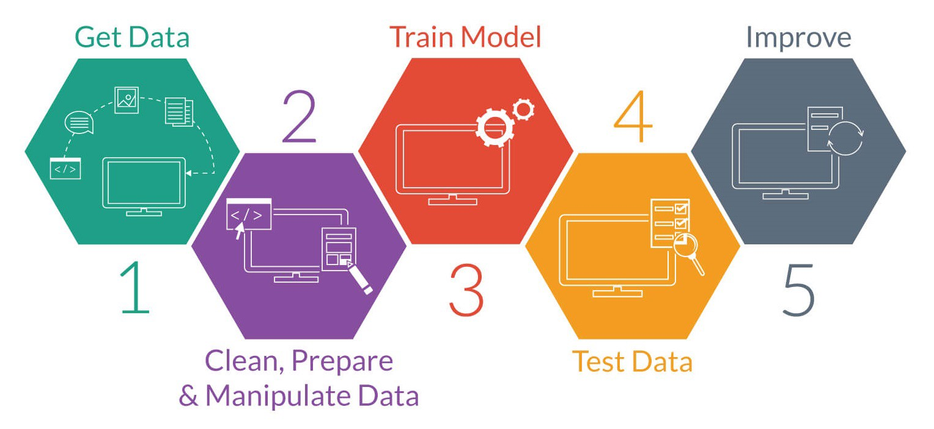
Steps involved in Machine Learning
This Photo by Unknown Author is licensed under CC BY-SA-NC

Slide 3
Confusion Matrix
Tabular summarization of the performance
 |  | Predicted Class
 |  | Positive | Negative
Actual Class | Positive | TP | FN
 | Negative | FP | TN

Slide 4
Confusion Matrix (contd…)
Cat vs Dog classification problem
Actual | C | C | D | C | D | D | C | D | C | D
Observed | D | C | C | C | D | C | D | D | C | D
 |  | Predicted Class
 |  | Positive | Negative
Actual Class | Positive
 | Negative

Slide 5
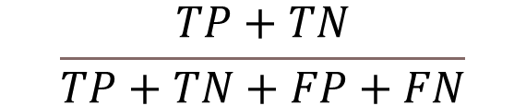

Performance Measures
Accuracy
Sensitivity or Recall

Slide 6
Performance measures (contd…)
Accuracy
Comment on the classifier, if accuracy is 80% ?
 |  | Predicted Class
 |  | Positive | Negative
Actual Class | Positive | TP | FN
 | Negative | FP | TN

Slide 7


Performance Measures
True Positive Fraction (Sensitivity)
False Positive Fraction
1-Specificity

Slide 8
Decision Model

Slide 9
Threshold

Slide 10
Threshold

Slide 11
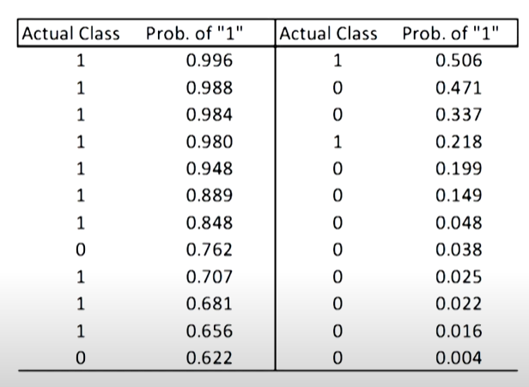
Output of Logistic regression
Unit-9, Lecture-41 & 42: https://nptel.ac.in/courses/106/107/106107220/

Slide 12
Performance measures (contd…)
 |  | Predicted Class
 |  | Positive | Negative
Actual Class | Positive | TP | FN Type-II error
 | Negative | FP Type-I error | TN

Slide 13
ROC: Receiver Operator Characteristics Curve

Slide 14
ROC
Effect of threshold on Sensitivity and Specificity

Slide 15
ROC

Slide 16
Good and Bad Classifiers

Slide 17
Analysis of Different points in ROC
Corner points
A(0,1): best
B(1,0): wrost
C(0,0): ultra-conservative i.e. every sample is -ve
D(1,1): Ultra-liberal i.e. every sample is +ve
Above diagonal
X(0.1, 0.6), Y(0.2,0.7), Z(0.2, 0.5)
Below diagonal
W(0.4,0.2)

Slide 18
Validation Measures for Clustering
External
use external information not present in the data
Internal
measures evaluate the goodness of a clustering structure without respect to external information

Slide 19
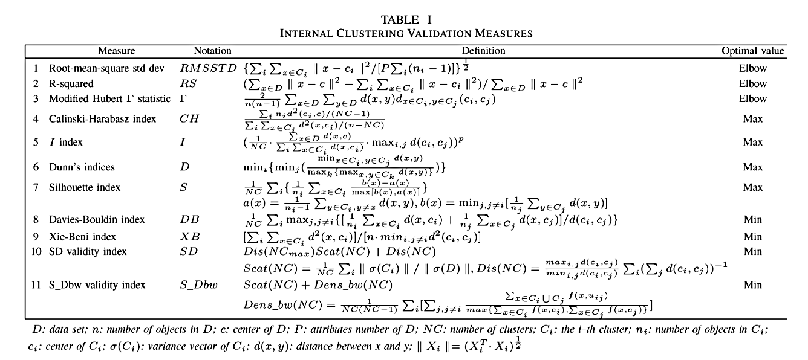
Validation Measures for Clustering

Slide 20
References
Ethem Alpaydin. 2010. Introduction to Machine Learning (2nd. ed.). The MIT Press.
Unit-9, Lecture-41 & 42: https://nptel.ac.in/courses/106/107/106107220/

